Slide 1



Slide 2


피보나찌 수열
하노이의 탑
조합 계산
1까지 줄이는 최소 스텝

Slide 3
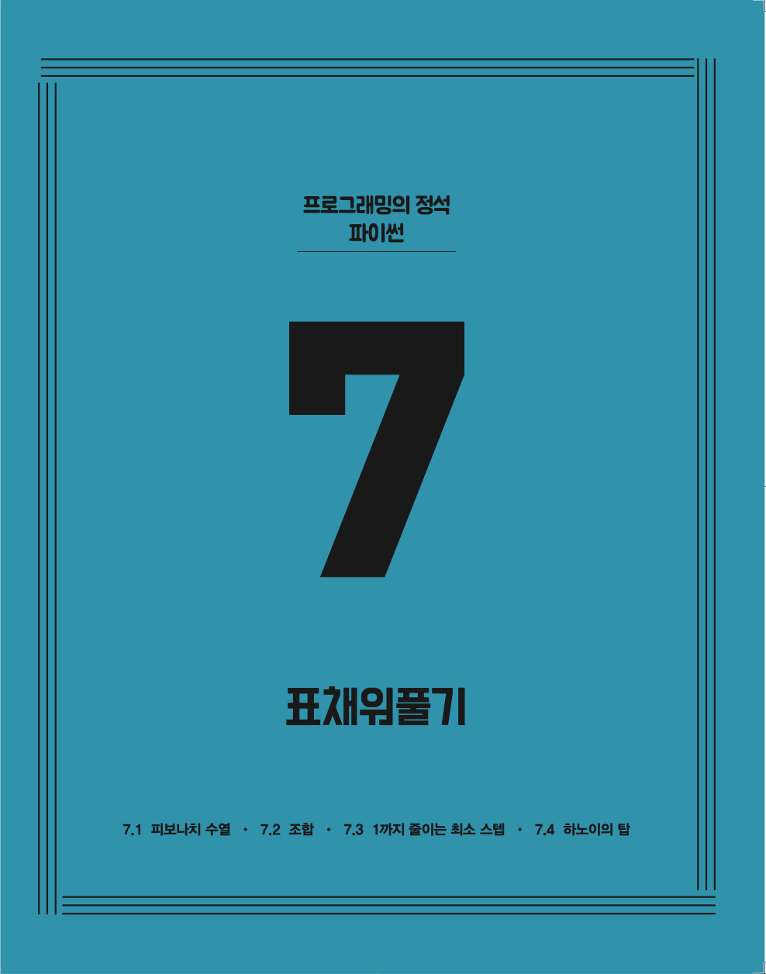




✔︎

Slide 4

피보나치 수열

Slide 5
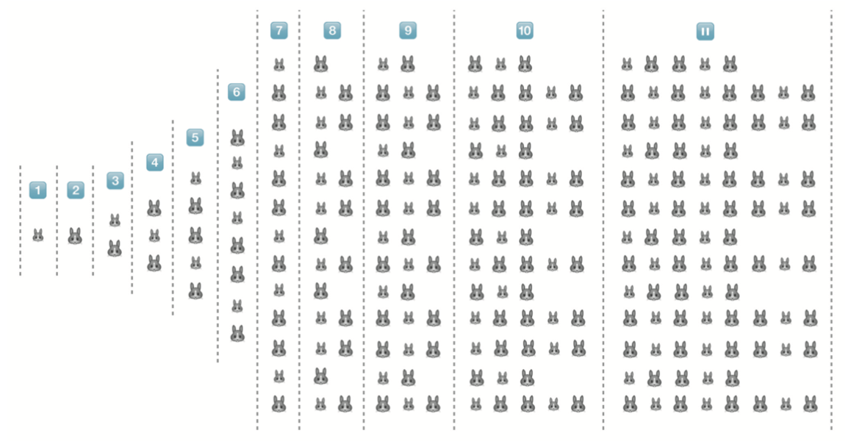
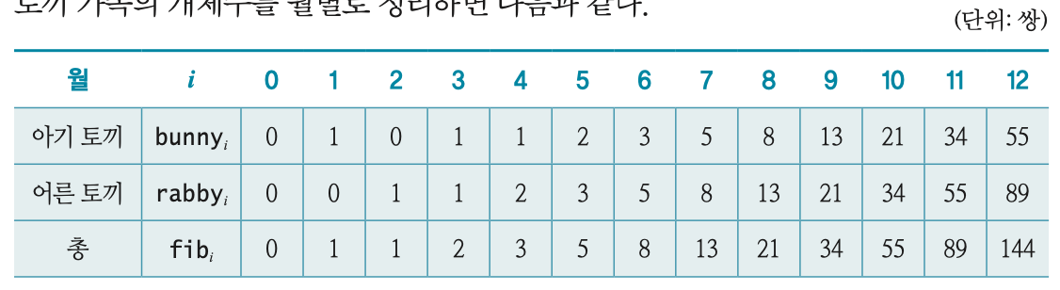

Slide 6

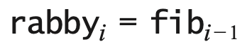
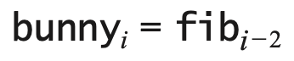
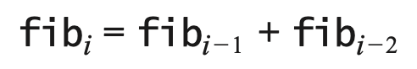

Slide 7
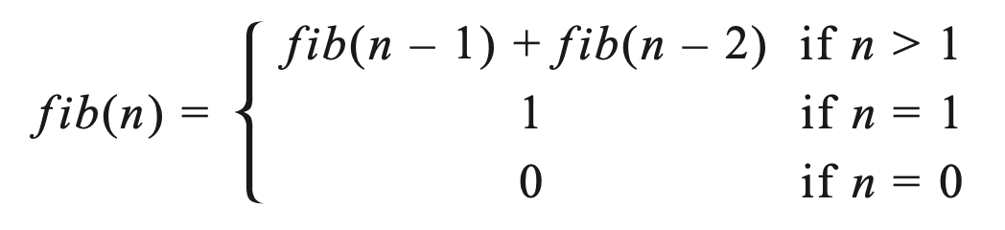
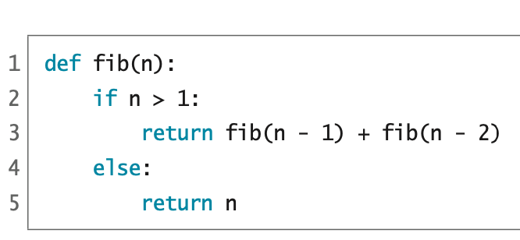
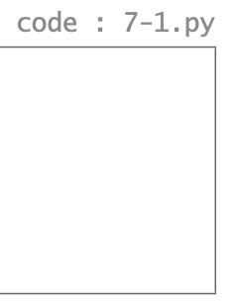
재귀 알고리즘

Slide 8
fib(5)
=>

Slide 9
fib(5)
=> fib(4) + fib(3)
=>

Slide 10
fib(5)
=> fib(4) + fib(3)
=> (fib(3) + fib(2)) + fib(3)
=>

Slide 11
fib(5)
=> fib(4) + fib(3)
=> (fib(3) + fib(2)) + fib(3)
=> ((fib(2) + fib(1)) + fib(2)) + fib(3)
=>

Slide 12
fib(5)
=> fib(4) + fib(3)
=> (fib(3) + fib(2)) + fib(3)
=> ((fib(2) + fib(1)) + fib(2)) + fib(3)
=> (((fib(1) + fib(0)) + fib(1)) + fib(2)) + fib(3)
=>

Slide 13
fib(5)
=> fib(4) + fib(3)
=> (fib(3) + fib(2)) + fib(3)
=> ((fib(2) + fib(1)) + fib(2)) + fib(3)
=> (((fib(1) + fib(0)) + fib(1)) + fib(2)) + fib(3)
=> (((1 + fib(0)) + fib(1)) + fib(2)) + fib(3)
=>

Slide 14
fib(5)
=> fib(4) + fib(3)
=> (fib(3) + fib(2)) + fib(3)
=> ((fib(2) + fib(1)) + fib(2)) + fib(3)
=> (((fib(1) + fib(0)) + fib(1)) + fib(2)) + fib(3)
=> (((1 + fib(0)) + fib(1)) + fib(2)) + fib(3)
=> (((1 + 0) + fib(1)) + fib(2)) + fib(3)
=>

Slide 15
fib(5)
=> fib(4) + fib(3)
=> (fib(3) + fib(2)) + fib(3)
=> ((fib(2) + fib(1)) + fib(2)) + fib(3)
=> (((fib(1) + fib(0)) + fib(1)) + fib(2)) + fib(3)
=> (((1 + fib(0)) + fib(1)) + fib(2)) + fib(3)
=> (((1 + 0) + fib(1)) + fib(2)) + fib(3)
=> ((1 + fib(1)) + fib(2)) + fib(3)
=>

Slide 16
fib(5)
=> fib(4) + fib(3)
=> (fib(3) + fib(2)) + fib(3)
=> ((fib(2) + fib(1)) + fib(2)) + fib(3)
=> (((fib(1) + fib(0)) + fib(1)) + fib(2)) + fib(3)
=> (((1 + fib(0)) + fib(1)) + fib(2)) + fib(3)
=> (((1 + 0) + fib(1)) + fib(2)) + fib(3)
=> ((1 + fib(1)) + fib(2)) + fib(3)
=> ((1 + 1) + fib(2)) + fib(3)
=>

Slide 17
fib(5)
=> fib(4) + fib(3)
=> (fib(3) + fib(2)) + fib(3)
=> ((fib(2) + fib(1)) + fib(2)) + fib(3)
=> (((fib(1) + fib(0)) + fib(1)) + fib(2)) + fib(3)
=> (((1 + fib(0)) + fib(1)) + fib(2)) + fib(3)
=> (((1 + 0) + fib(1)) + fib(2)) + fib(3)
=> ((1 + fib(1)) + fib(2)) + fib(3)
=> ((1 + 1) + fib(2)) + fib(3)
=> (2 + fib(2)) + fib(3)
=>

Slide 18
fib(5)
=> fib(4) + fib(3)
=> (fib(3) + fib(2)) + fib(3)
=> ((fib(2) + fib(1)) + fib(2)) + fib(3)
=> (((fib(1) + fib(0)) + fib(1)) + fib(2)) + fib(3)
=> (((1 + fib(0)) + fib(1)) + fib(2)) + fib(3)
=> (((1 + 0) + fib(1)) + fib(2)) + fib(3)
=> ((1 + fib(1)) + fib(2)) + fib(3)
=> ((1 + 1) + fib(2)) + fib(3)
=> (2 + fib(2)) + fib(3)
=> (2 + (fib(1) + fib(0))) + fib(3)
=>

Slide 19
fib(5)
=> fib(4) + fib(3)
=> (fib(3) + fib(2)) + fib(3)
=> ((fib(2) + fib(1)) + fib(2)) + fib(3)
=> (((fib(1) + fib(0)) + fib(1)) + fib(2)) + fib(3)
=> (((1 + fib(0)) + fib(1)) + fib(2)) + fib(3)
=> (((1 + 0) + fib(1)) + fib(2)) + fib(3)
=> ((1 + fib(1)) + fib(2)) + fib(3)
=> ((1 + 1) + fib(2)) + fib(3)
=> (2 + fib(2)) + fib(3)
=> (2 + (fib(1) + fib(0))) + fib(3)
=> (2 + (1 + fib(0))) + fib(3)
=>

Slide 20
fib(5)
=> fib(4) + fib(3)
=> (fib(3) + fib(2)) + fib(3)
=> ((fib(2) + fib(1)) + fib(2)) + fib(3)
=> (((fib(1) + fib(0)) + fib(1)) + fib(2)) + fib(3)
=> (((1 + fib(0)) + fib(1)) + fib(2)) + fib(3)
=> (((1 + 0) + fib(1)) + fib(2)) + fib(3)
=> ((1 + fib(1)) + fib(2)) + fib(3)
=> ((1 + 1) + fib(2)) + fib(3)
=> (2 + fib(2)) + fib(3)
=> (2 + (fib(1) + fib(0))) + fib(3)
=> (2 + (1 + fib(0))) + fib(3)
=> (2 + (1 + 0)) + fib(3)
=>

Slide 21
fib(5)
=> fib(4) + fib(3)
=> (fib(3) + fib(2)) + fib(3)
=> ((fib(2) + fib(1)) + fib(2)) + fib(3)
=> (((fib(1) + fib(0)) + fib(1)) + fib(2)) + fib(3)
=> (((1 + fib(0)) + fib(1)) + fib(2)) + fib(3)
=> (((1 + 0) + fib(1)) + fib(2)) + fib(3)
=> ((1 + fib(1)) + fib(2)) + fib(3)
=> ((1 + 1) + fib(2)) + fib(3)
=> (2 + fib(2)) + fib(3)
=> (2 + (fib(1) + fib(0))) + fib(3)
=> (2 + (1 + fib(0))) + fib(3)
=> (2 + (1 + 0)) + fib(3)
=> (2 + 1) + fib(3)
=>

Slide 22
fib(5)
=> fib(4) + fib(3)
=> (fib(3) + fib(2)) + fib(3)
=> ((fib(2) + fib(1)) + fib(2)) + fib(3)
=> (((fib(1) + fib(0)) + fib(1)) + fib(2)) + fib(3)
=> (((1 + fib(0)) + fib(1)) + fib(2)) + fib(3)
=> (((1 + 0) + fib(1)) + fib(2)) + fib(3)
=> ((1 + fib(1)) + fib(2)) + fib(3)
=> ((1 + 1) + fib(2)) + fib(3)
=> (2 + fib(2)) + fib(3)
=> (2 + (fib(1) + fib(0))) + fib(3)
=> (2 + (1 + fib(0))) + fib(3)
=> (2 + (1 + 0)) + fib(3)
=> (2 + 1) + fib(3)
=> 3 + fib(3)
=>

Slide 23
fib(5)
=> fib(4) + fib(3)
=> (fib(3) + fib(2)) + fib(3)
=> ((fib(2) + fib(1)) + fib(2)) + fib(3)
=> (((fib(1) + fib(0)) + fib(1)) + fib(2)) + fib(3)
=> (((1 + fib(0)) + fib(1)) + fib(2)) + fib(3)
=> (((1 + 0) + fib(1)) + fib(2)) + fib(3)
=> ((1 + fib(1)) + fib(2)) + fib(3)
=> ((1 + 1) + fib(2)) + fib(3)
=> (2 + fib(2)) + fib(3)
=> (2 + (fib(1) + fib(0))) + fib(3)
=> (2 + (1 + fib(0))) + fib(3)
=> (2 + (1 + 0)) + fib(3)
=> (2 + 1) + fib(3)
=> 3 + fib(3)
=> 3 + (fib(2) + fib(1))
=>

Slide 24
fib(5)
=> fib(4) + fib(3)
=> (fib(3) + fib(2)) + fib(3)
=> ((fib(2) + fib(1)) + fib(2)) + fib(3)
=> (((fib(1) + fib(0)) + fib(1)) + fib(2)) + fib(3)
=> (((1 + fib(0)) + fib(1)) + fib(2)) + fib(3)
=> (((1 + 0) + fib(1)) + fib(2)) + fib(3)
=> ((1 + fib(1)) + fib(2)) + fib(3)
=> ((1 + 1) + fib(2)) + fib(3)
=> (2 + fib(2)) + fib(3)
=> (2 + (fib(1) + fib(0))) + fib(3)
=> (2 + (1 + fib(0))) + fib(3)
=> (2 + (1 + 0)) + fib(3)
=> (2 + 1) + fib(3)
=> 3 + fib(3)
=> 3 + (fib(2) + fib(1))
=> 3 + ((fib(1) + fib(0)) + fib(1))
=>

Slide 25
fib(5)
=> fib(4) + fib(3)
=> (fib(3) + fib(2)) + fib(3)
=> ((fib(2) + fib(1)) + fib(2)) + fib(3)
=> (((fib(1) + fib(0)) + fib(1)) + fib(2)) + fib(3)
=> (((1 + fib(0)) + fib(1)) + fib(2)) + fib(3)
=> (((1 + 0) + fib(1)) + fib(2)) + fib(3)
=> ((1 + fib(1)) + fib(2)) + fib(3)
=> ((1 + 1) + fib(2)) + fib(3)
=> (2 + fib(2)) + fib(3)
=> (2 + (fib(1) + fib(0))) + fib(3)
=> (2 + (1 + fib(0))) + fib(3)
=> (2 + (1 + 0)) + fib(3)
=> (2 + 1) + fib(3)
=> 3 + fib(3)
=> 3 + (fib(2) + fib(1))
=> 3 + ((fib(1) + fib(0)) + fib(1))
=> 3 + ((1 + fib(0)) + fib(1))
=>

Slide 26
fib(5)
=> fib(4) + fib(3)
=> (fib(3) + fib(2)) + fib(3)
=> ((fib(2) + fib(1)) + fib(2)) + fib(3)
=> (((fib(1) + fib(0)) + fib(1)) + fib(2)) + fib(3)
=> (((1 + fib(0)) + fib(1)) + fib(2)) + fib(3)
=> (((1 + 0) + fib(1)) + fib(2)) + fib(3)
=> ((1 + fib(1)) + fib(2)) + fib(3)
=> ((1 + 1) + fib(2)) + fib(3)
=> (2 + fib(2)) + fib(3)
=> (2 + (fib(1) + fib(0))) + fib(3)
=> (2 + (1 + fib(0))) + fib(3)
=> (2 + (1 + 0)) + fib(3)
=> (2 + 1) + fib(3)
=> 3 + fib(3)
=> 3 + (fib(2) + fib(1))
=> 3 + ((fib(1) + fib(0)) + fib(1))
=> 3 + ((1 + fib(0)) + fib(1))
=> 3 + ((1 + 0) + fib(1))
=>

Slide 27
fib(5)
=> fib(4) + fib(3)
=> (fib(3) + fib(2)) + fib(3)
=> ((fib(2) + fib(1)) + fib(2)) + fib(3)
=> (((fib(1) + fib(0)) + fib(1)) + fib(2)) + fib(3)
=> (((1 + fib(0)) + fib(1)) + fib(2)) + fib(3)
=> (((1 + 0) + fib(1)) + fib(2)) + fib(3)
=> ((1 + fib(1)) + fib(2)) + fib(3)
=> ((1 + 1) + fib(2)) + fib(3)
=> (2 + fib(2)) + fib(3)
=> (2 + (fib(1) + fib(0))) + fib(3)
=> (2 + (1 + fib(0))) + fib(3)
=> (2 + (1 + 0)) + fib(3)
=> (2 + 1) + fib(3)
=> 3 + fib(3)
=> 3 + (fib(2) + fib(1))
=> 3 + ((fib(1) + fib(0)) + fib(1))
=> 3 + ((1 + fib(0)) + fib(1))
=> 3 + ((1 + 0) + fib(1))
=> 3 + (1 + fib(1))
=>

Slide 28
fib(5)
=> fib(4) + fib(3)
=> (fib(3) + fib(2)) + fib(3)
=> ((fib(2) + fib(1)) + fib(2)) + fib(3)
=> (((fib(1) + fib(0)) + fib(1)) + fib(2)) + fib(3)
=> (((1 + fib(0)) + fib(1)) + fib(2)) + fib(3)
=> (((1 + 0) + fib(1)) + fib(2)) + fib(3)
=> ((1 + fib(1)) + fib(2)) + fib(3)
=> ((1 + 1) + fib(2)) + fib(3)
=> (2 + fib(2)) + fib(3)
=> (2 + (fib(1) + fib(0))) + fib(3)
=> (2 + (1 + fib(0))) + fib(3)
=> (2 + (1 + 0)) + fib(3)
=> (2 + 1) + fib(3)
=> 3 + fib(3)
=> 3 + (fib(2) + fib(1))
=> 3 + ((fib(1) + fib(0)) + fib(1))
=> 3 + ((1 + fib(0)) + fib(1))
=> 3 + ((1 + 0) + fib(1))
=> 3 + (1 + fib(1))
=> 3 + (1 + 1)
=>

Slide 29
fib(5)
=> fib(4) + fib(3)
=> (fib(3) + fib(2)) + fib(3)
=> ((fib(2) + fib(1)) + fib(2)) + fib(3)
=> (((fib(1) + fib(0)) + fib(1)) + fib(2)) + fib(3)
=> (((1 + fib(0)) + fib(1)) + fib(2)) + fib(3)
=> (((1 + 0) + fib(1)) + fib(2)) + fib(3)
=> ((1 + fib(1)) + fib(2)) + fib(3)
=> ((1 + 1) + fib(2)) + fib(3)
=> (2 + fib(2)) + fib(3)
=> (2 + (fib(1) + fib(0))) + fib(3)
=> (2 + (1 + fib(0))) + fib(3)
=> (2 + (1 + 0)) + fib(3)
=> (2 + 1) + fib(3)
=> 3 + fib(3)
=> 3 + (fib(2) + fib(1))
=> 3 + ((fib(1) + fib(0)) + fib(1))
=> 3 + ((1 + fib(0)) + fib(1))
=> 3 + ((1 + 0) + fib(1))
=> 3 + (1 + fib(1))
=> 3 + (1 + 1)
=> 3 + 2
=>

Slide 30
fib(5)
=> fib(4) + fib(3)
=> (fib(3) + fib(2)) + fib(3)
=> ((fib(2) + fib(1)) + fib(2)) + fib(3)
=> (((fib(1) + fib(0)) + fib(1)) + fib(2)) + fib(3)
=> (((1 + fib(0)) + fib(1)) + fib(2)) + fib(3)
=> (((1 + 0) + fib(1)) + fib(2)) + fib(3)
=> ((1 + fib(1)) + fib(2)) + fib(3)
=> ((1 + 1) + fib(2)) + fib(3)
=> (2 + fib(2)) + fib(3)
=> (2 + (fib(1) + fib(0))) + fib(3)
=> (2 + (1 + fib(0))) + fib(3)
=> (2 + (1 + 0)) + fib(3)
=> (2 + 1) + fib(3)
=> 3 + fib(3)
=> 3 + (fib(2) + fib(1))
=> 3 + ((fib(1) + fib(0)) + fib(1))
=> 3 + ((1 + fib(0)) + fib(1))
=> 3 + ((1 + 0) + fib(1))
=> 3 + (1 + fib(1))
=> 3 + (1 + 1)
=> 3 + 2
=> 5

Slide 31
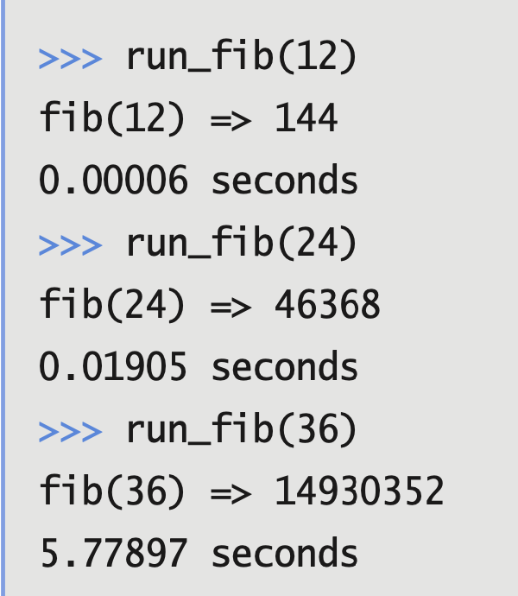
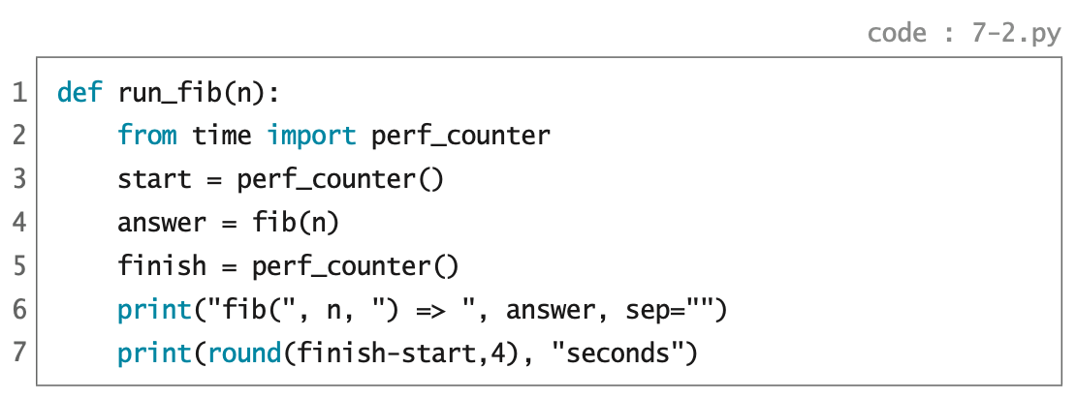
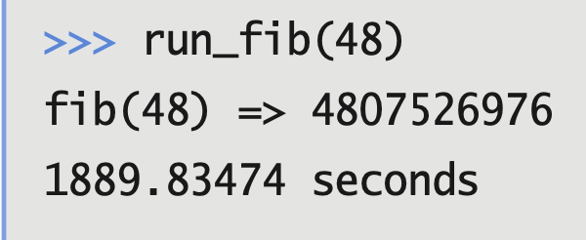
>>> run_fib(60)

Slide 32
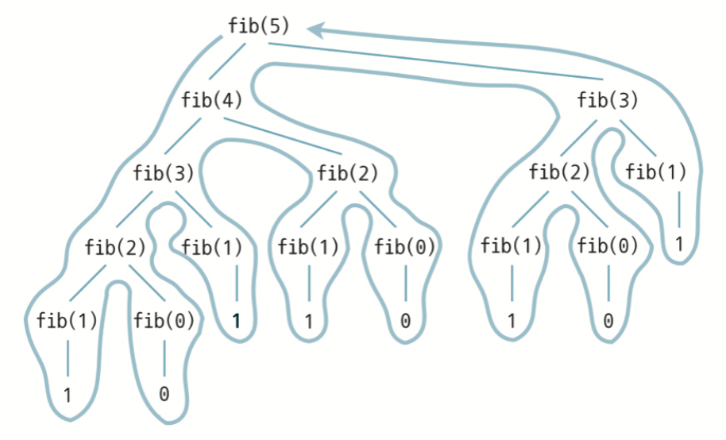
재귀 알고리즘의 계산 복잡도
트리 재귀
Tree Recursion
깊이우선 트리 훑기
Depth-first Tree Traversal

Slide 33
표채워풀기 알고리즘
Dynamic Programming
fib(0) = 0
fib(1) = 1
fib(2) =

Slide 34
표채워풀기 알고리즘
Dynamic Programming
fib(0) = 0
fib(1) = 1
fib(2) = fib(1) + fib(0) = 1 + 0 = 1
fib(3) =

Slide 35
표채워풀기 알고리즘
Dynamic Programming
fib(0) = 0
fib(1) = 1
fib(2) = fib(1) + fib(0) = 1 + 0 = 1
fib(3) = fib(2) + fib(1) = 1 + 1 = 2
fib(4) =

Slide 36
표채워풀기 알고리즘
Dynamic Programming
fib(0) = 0
fib(1) = 1
fib(2) = fib(1) + fib(0) = 1 + 0 = 1
fib(3) = fib(2) + fib(1) = 1 + 1 = 2
fib(4) = fib(3) + fib(2) = 2 + 1 = 3
fib(5) =

Slide 37
표채워풀기 알고리즘
Dynamic Programming
fib(0) = 0
fib(1) = 1
fib(2) = fib(1) + fib(0) = 1 + 0 = 1
fib(3) = fib(2) + fib(1) = 1 + 1 = 2
fib(4) = fib(3) + fib(2) = 2 + 1 = 3
fib(5) = fib(4) + fib(3) = 3 + 2 = 5
fib(6) =

Slide 38
표채워풀기 알고리즘
Dynamic Programming
fib(0) = 0
fib(1) = 1
fib(2) = fib(1) + fib(0) = 1 + 0 = 1
fib(3) = fib(2) + fib(1) = 1 + 1 = 2
fib(4) = fib(3) + fib(2) = 2 + 1 = 3
fib(5) = fib(4) + fib(3) = 3 + 2 = 5
fib(6) = fib(5) + fib(4) = 5 + 3 = 8
fib(7) =

Slide 39
표채워풀기 알고리즘
Dynamic Programming
fib(0) = 0
fib(1) = 1
fib(2) = fib(1) + fib(0) = 1 + 0 = 1
fib(3) = fib(2) + fib(1) = 1 + 1 = 2
fib(4) = fib(3) + fib(2) = 2 + 1 = 3
fib(5) = fib(4) + fib(3) = 3 + 2 = 5
fib(6) = fib(5) + fib(4) = 5 + 3 = 8
fib(7) = fib(6) + fib(5) = 8 + 5 = 13
fib(8) =

Slide 40
표채워풀기 알고리즘
Dynamic Programming
fib(0) = 0
fib(1) = 1
fib(2) = fib(1) + fib(0) = 1 + 0 = 1
fib(3) = fib(2) + fib(1) = 1 + 1 = 2
fib(4) = fib(3) + fib(2) = 2 + 1 = 3
fib(5) = fib(4) + fib(3) = 3 + 2 = 5
fib(6) = fib(5) + fib(4) = 5 + 3 = 8
fib(7) = fib(6) + fib(5) = 8 + 5 = 13
fib(8) = fib(7) + fib(6) = 13 + 8 = 21
fib(9) =

Slide 41
표채워풀기 알고리즘
Dynamic Programming
fib(0) = 0
fib(1) = 1
fib(2) = fib(1) + fib(0) = 1 + 0 = 1
fib(3) = fib(2) + fib(1) = 1 + 1 = 2
fib(4) = fib(3) + fib(2) = 2 + 1 = 3
fib(5) = fib(4) + fib(3) = 3 + 2 = 5
fib(6) = fib(5) + fib(4) = 5 + 3 = 8
fib(7) = fib(6) + fib(5) = 8 + 5 = 13
fib(8) = fib(7) + fib(6) = 13 + 8 = 21
fib(9) = fib(8) + fib(7) = 21 + 13 = 34
fib(10) =

Slide 42
표채워풀기 알고리즘
Dynamic Programming
fib(0) = 0
fib(1) = 1
fib(2) = fib(1) + fib(0) = 1 + 0 = 1
fib(3) = fib(2) + fib(1) = 1 + 1 = 2
fib(4) = fib(3) + fib(2) = 2 + 1 = 3
fib(5) = fib(4) + fib(3) = 3 + 2 = 5
fib(6) = fib(5) + fib(4) = 5 + 3 = 8
fib(7) = fib(6) + fib(5) = 8 + 5 = 13
fib(8) = fib(7) + fib(6) = 13 + 8 = 21
fib(9) = fib(8) + fib(7) = 21 + 13 = 34
fib(10) = fib(9) + fib(8) = 34 + 21 = 55
fib(11) =

Slide 43
표채워풀기 알고리즘
Dynamic Programming
fib(0) = 0
fib(1) = 1
fib(2) = fib(1) + fib(0) = 1 + 0 = 1
fib(3) = fib(2) + fib(1) = 1 + 1 = 2
fib(4) = fib(3) + fib(2) = 2 + 1 = 3
fib(5) = fib(4) + fib(3) = 3 + 2 = 5
fib(6) = fib(5) + fib(4) = 5 + 3 = 8
fib(7) = fib(6) + fib(5) = 8 + 5 = 13
fib(8) = fib(7) + fib(6) = 13 + 8 = 21
fib(9) = fib(8) + fib(7) = 21 + 13 = 34
fib(10) = fib(9) + fib(8) = 34 + 21 = 55
fib(11) = fib(10) + fib(9) = 55 + 34 = 89
fib(12) =

Slide 44
표채워풀기 알고리즘
Dynamic Programming
fib(0) = 0
fib(1) = 1
fib(2) = fib(1) + fib(0) = 1 + 0 = 1
fib(3) = fib(2) + fib(1) = 1 + 1 = 2
fib(4) = fib(3) + fib(2) = 2 + 1 = 3
fib(5) = fib(4) + fib(3) = 3 + 2 = 5
fib(6) = fib(5) + fib(4) = 5 + 3 = 8
fib(7) = fib(6) + fib(5) = 8 + 5 = 13
fib(8) = fib(7) + fib(6) = 13 + 8 = 21
fib(9) = fib(8) + fib(7) = 21 + 13 = 34
fib(10) = fib(9) + fib(8) = 34 + 21 = 55
fib(11) = fib(10) + fib(9) = 55 + 34 = 89
fib(12) = fib(11) + fib(10) = 89 + 55 = 144

Slide 45
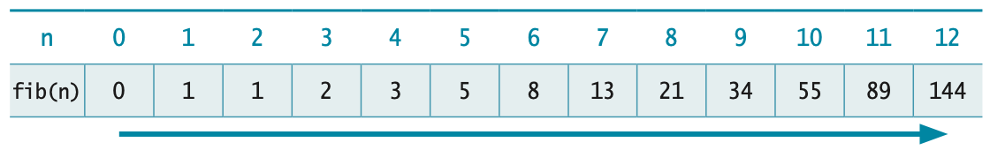
표채워풀기 알고리즘
Dynamic Programming
fib(0) = 0
fib(1) = 1
fib(2) = fib(1) + fib(0) = 1 + 0 = 1
fib(3) = fib(2) + fib(1) = 1 + 1 = 2
fib(4) = fib(3) + fib(2) = 2 + 1 = 3
fib(5) = fib(4) + fib(3) = 3 + 2 = 5
fib(6) = fib(5) + fib(4) = 5 + 3 = 8
fib(7) = fib(6) + fib(5) = 8 + 5 = 13
fib(8) = fib(7) + fib(6) = 13 + 8 = 21
fib(9) = fib(8) + fib(7) = 21 + 13 = 34
fib(10) = fib(9) + fib(8) = 34 + 21 = 55
fib(11) = fib(10) + fib(9) = 55 + 34 = 89
fib(12) = fib(11) + fib(10) = 89 + 55 = 144

Slide 46
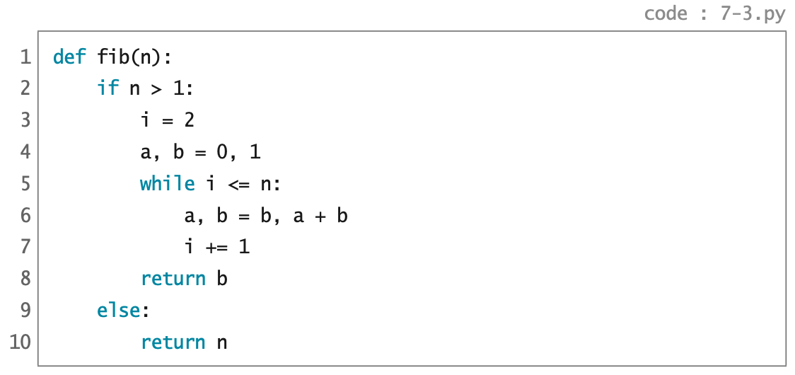
i
a
b

Slide 47
i
a
b

Slide 48
i
a
b

Slide 49
i
a
b

Slide 50
i
a
b

Slide 51
i
a
b

Slide 52
i
a
b

Slide 53
i
a
b

Slide 54
i
a
b

Slide 55
i
a
b

Slide 56
i
a
b

Slide 57
i
a
b

Slide 58
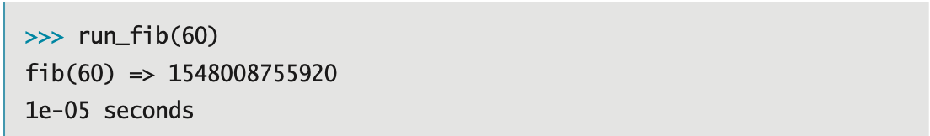
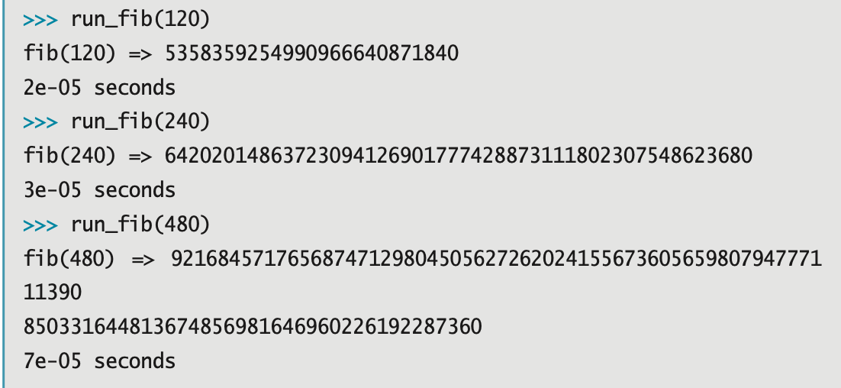
표채워풀기 알고리즘의 계산 복잡도

Slide 59
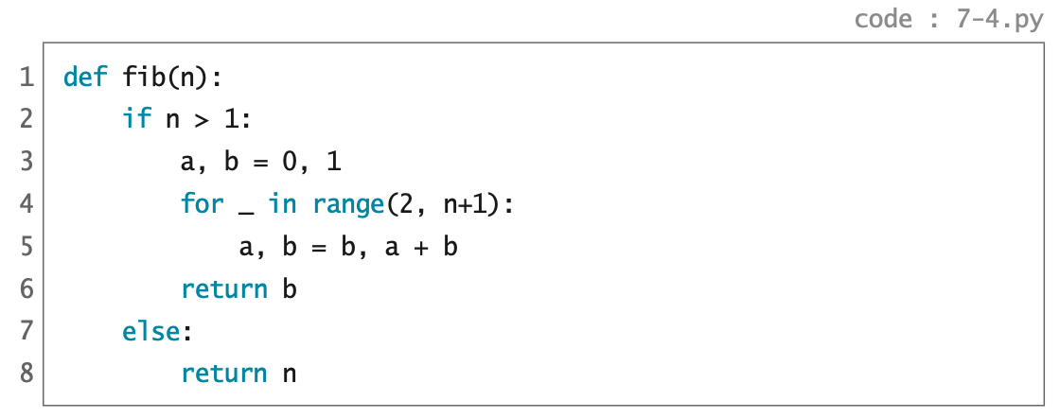
while 루프
for 루프

Slide 60
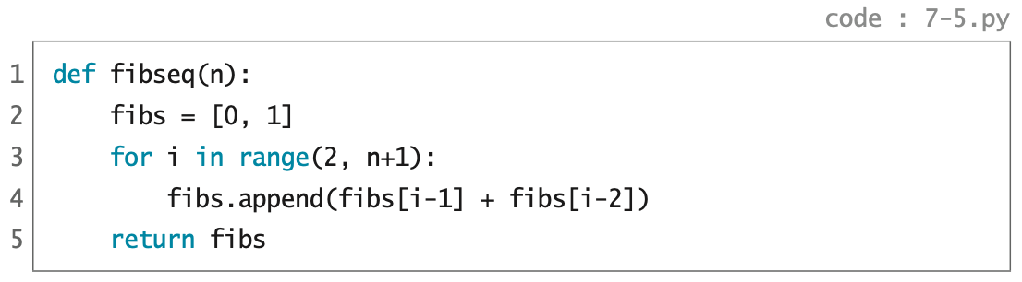
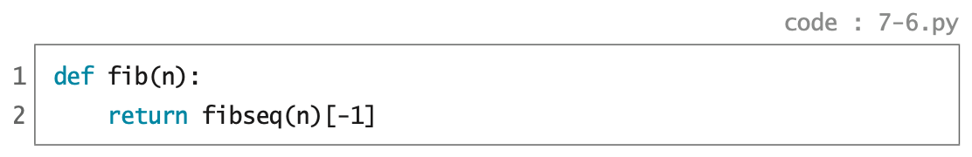

Slide 61
✔︎

Slide 62
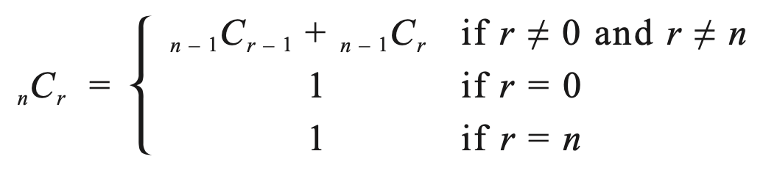
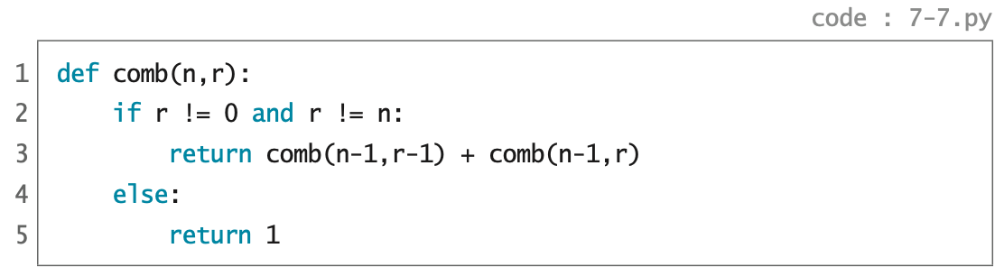
조합
Combination

Slide 63

p.342

Slide 64
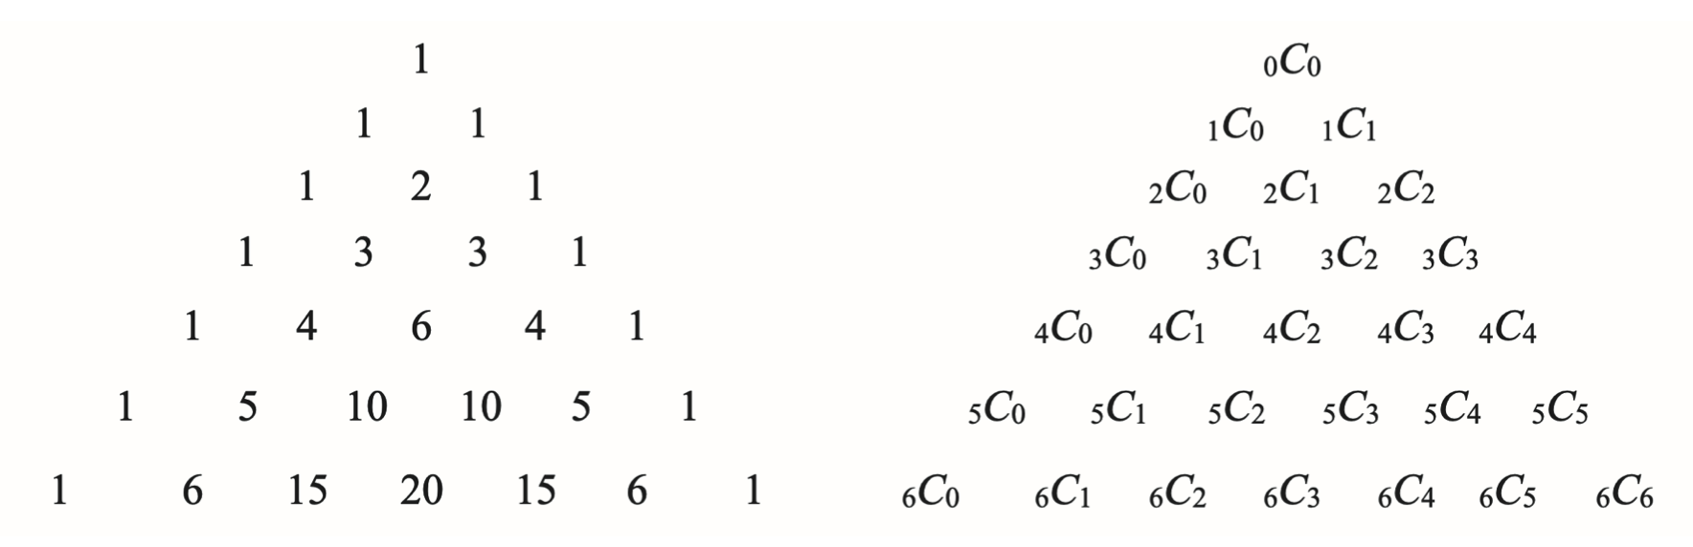
파스칼의 삼각형
표채워풀기 알고리즘

Slide 65
파스칼의 삼각형
표채워풀기 알고리즘

Slide 66
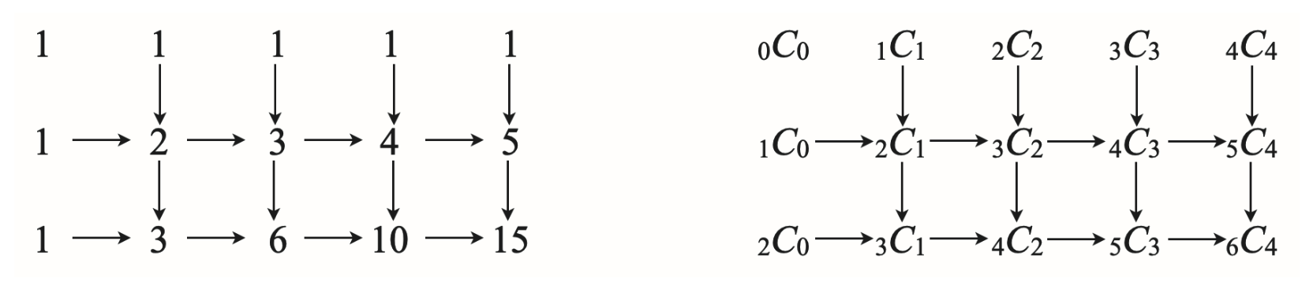
파스칼의 삼각형
표채워풀기 알고리즘

Slide 67
파스칼의 삼각형
표채워풀기 알고리즘
행렬
행 = 가로줄 = row
렬 = 세로줄 = column
Matrix

Slide 68
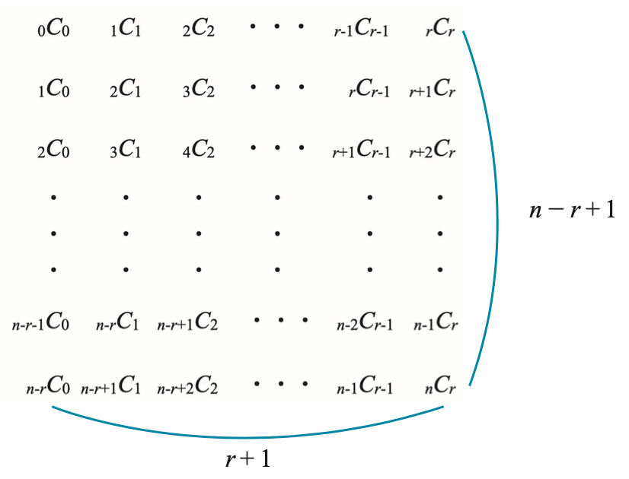
파스칼의 삼각형
표채워풀기 알고리즘

Slide 69
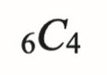
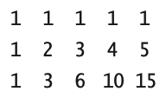
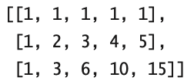
파스칼의 삼각형
표채워풀기 구현
중첩 리스트
Nested List
[[1, 1, 1, 1, 1], [1], [1]]
=>

Slide 70
파스칼의 삼각형
표채워풀기 구현
[[1, 1, 1, 1, 1], [1], [1]]
=> [[1, 1, 1, 1, 1], [1, 2], [1]]
=>

Slide 71
파스칼의 삼각형
표채워풀기 구현
[[1, 1, 1, 1, 1], [1], [1]]
=> [[1, 1, 1, 1, 1], [1, 2], [1]]
=> [[1, 1, 1, 1, 1], [1, 2, 3], [1]]
=>

Slide 72
파스칼의 삼각형
표채워풀기 구현
[[1, 1, 1, 1, 1], [1], [1]]
=> [[1, 1, 1, 1, 1], [1, 2], [1]]
=> [[1, 1, 1, 1, 1], [1, 2, 3], [1]]
=> [[1, 1, 1, 1, 1], [1, 2, 3, 4], [1]]
=>

Slide 73
파스칼의 삼각형
표채워풀기 구현
[[1, 1, 1, 1, 1], [1], [1]]
=> [[1, 1, 1, 1, 1], [1, 2], [1]]
=> [[1, 1, 1, 1, 1], [1, 2, 3], [1]]
=> [[1, 1, 1, 1, 1], [1, 2, 3, 4], [1]]
=> [[1, 1, 1, 1, 1], [1, 2, 3, 4, 5], [1]]
=>

Slide 74
파스칼의 삼각형
표채워풀기 구현
[[1, 1, 1, 1, 1], [1], [1]]
=> [[1, 1, 1, 1, 1], [1, 2], [1]]
=> [[1, 1, 1, 1, 1], [1, 2, 3], [1]]
=> [[1, 1, 1, 1, 1], [1, 2, 3, 4], [1]]
=> [[1, 1, 1, 1, 1], [1, 2, 3, 4, 5], [1]]
=> [[1, 1, 1, 1, 1], [1, 2, 3, 4, 5], [1, 3]]
=>

Slide 75
파스칼의 삼각형
표채워풀기 구현
[[1, 1, 1, 1, 1], [1], [1]]
=> [[1, 1, 1, 1, 1], [1, 2], [1]]
=> [[1, 1, 1, 1, 1], [1, 2, 3], [1]]
=> [[1, 1, 1, 1, 1], [1, 2, 3, 4], [1]]
=> [[1, 1, 1, 1, 1], [1, 2, 3, 4, 5], [1]]
=> [[1, 1, 1, 1, 1], [1, 2, 3, 4, 5], [1, 3]]
=> [[1, 1, 1, 1, 1], [1, 2, 3, 4, 5], [1, 3, 6]]
=>

Slide 76
파스칼의 삼각형
표채워풀기 구현
[[1, 1, 1, 1, 1], [1], [1]]
=> [[1, 1, 1, 1, 1], [1, 2], [1]]
=> [[1, 1, 1, 1, 1], [1, 2, 3], [1]]
=> [[1, 1, 1, 1, 1], [1, 2, 3, 4], [1]]
=> [[1, 1, 1, 1, 1], [1, 2, 3, 4, 5], [1]]
=> [[1, 1, 1, 1, 1], [1, 2, 3, 4, 5], [1, 3]]
=> [[1, 1, 1, 1, 1], [1, 2, 3, 4, 5], [1, 3, 6]]
=> [[1, 1, 1, 1, 1], [1, 2, 3, 4, 5], [1, 3, 6, 10]]
=>

Slide 77
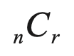
파스칼의 삼각형
표채워풀기 구현
[[1, 1, 1, 1, 1], [1], [1]]
=> [[1, 1, 1, 1, 1], [1, 2], [1]]
=> [[1, 1, 1, 1, 1], [1, 2, 3], [1]]
=> [[1, 1, 1, 1, 1], [1, 2, 3, 4], [1]]
=> [[1, 1, 1, 1, 1], [1, 2, 3, 4, 5], [1]]
=> [[1, 1, 1, 1, 1], [1, 2, 3, 4, 5], [1, 3]]
=> [[1, 1, 1, 1, 1], [1, 2, 3, 4, 5], [1, 3, 6]]
=> [[1, 1, 1, 1, 1], [1, 2, 3, 4, 5], [1, 3, 6, 10]]
=> [[1, 1, 1, 1, 1], [1, 2, 3, 4, 5], [1, 3, 6, 10, 15]]

Slide 78
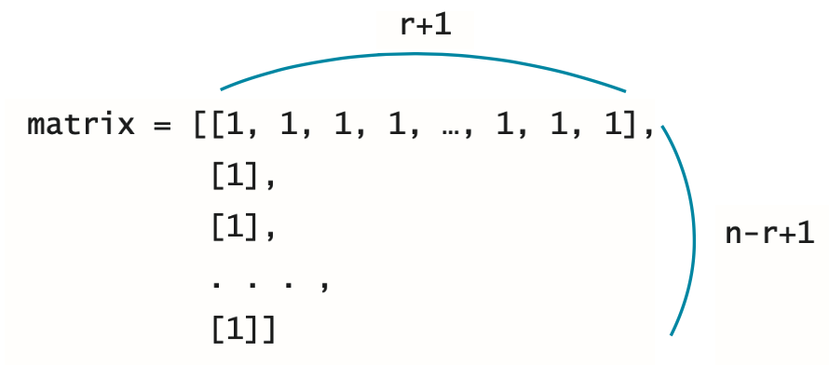
파스칼의 삼각형
표채워풀기 구현
리스트 축약
List Comprehension

Slide 79
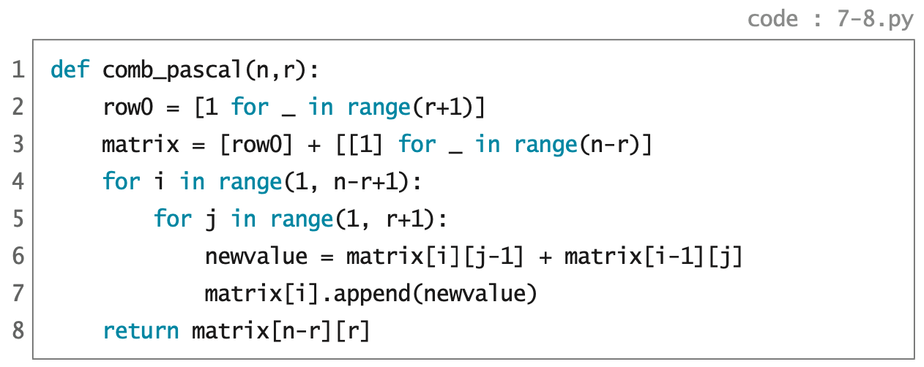

Slide 80
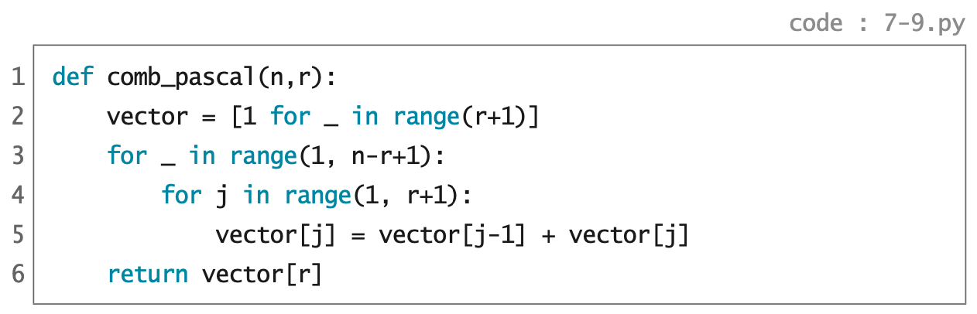
comb_pascal(6,4)
vector = [1, 1, 1, 1, 1]
=>

Slide 81
comb_pascal(6,4)
vector = [1, 1, 1, 1, 1]
=> [1, 2, 1, 1, 1]
=>

Slide 82
comb_pascal(6,4)
vector = [1, 1, 1, 1, 1]
=> [1, 2, 1, 1, 1]
=> [1, 2, 3, 1, 1]
=>

Slide 83
comb_pascal(6,4)
vector = [1, 1, 1, 1, 1]
=> [1, 2, 1, 1, 1]
=> [1, 2, 3, 1, 1]
=> [1, 2, 3, 4, 1]
=>

Slide 84
comb_pascal(6,4)
vector = [1, 1, 1, 1, 1]
=> [1, 2, 1, 1, 1]
=> [1, 2, 3, 1, 1]
=> [1, 2, 3, 4, 1]
=> [1, 2, 3, 4, 5]
=>

Slide 85
comb_pascal(6,4)
vector = [1, 1, 1, 1, 1]
=> [1, 2, 1, 1, 1]
=> [1, 2, 3, 1, 1]
=> [1, 2, 3, 4, 1]
=> [1, 2, 3, 4, 5]
=> [1, 3, 3, 4, 5]
=>

Slide 86
comb_pascal(6,4)
vector = [1, 1, 1, 1, 1]
=> [1, 2, 1, 1, 1]
=> [1, 2, 3, 1, 1]
=> [1, 2, 3, 4, 1]
=> [1, 2, 3, 4, 5]
=> [1, 3, 3, 4, 5]
=> [1, 3, 6, 4, 5]
=>

Slide 87
comb_pascal(6,4)
vector = [1, 1, 1, 1, 1]
=> [1, 2, 1, 1, 1]
=> [1, 2, 3, 1, 1]
=> [1, 2, 3, 4, 1]
=> [1, 2, 3, 4, 5]
=> [1, 3, 3, 4, 5]
=> [1, 3, 6, 4, 5]
=> [1, 3, 6, 10, 5]
=>

Slide 88
comb_pascal(6,4)
vector = [1, 1, 1, 1, 1]
=> [1, 2, 1, 1, 1]
=> [1, 2, 3, 1, 1]
=> [1, 2, 3, 4, 1]
=> [1, 2, 3, 4, 5]
=> [1, 3, 3, 4, 5]
=> [1, 3, 6, 4, 5]
=> [1, 3, 6, 10, 5]
=> [1, 3, 6, 10, 15]

Slide 89

p.349

Slide 90
✔︎

Slide 91
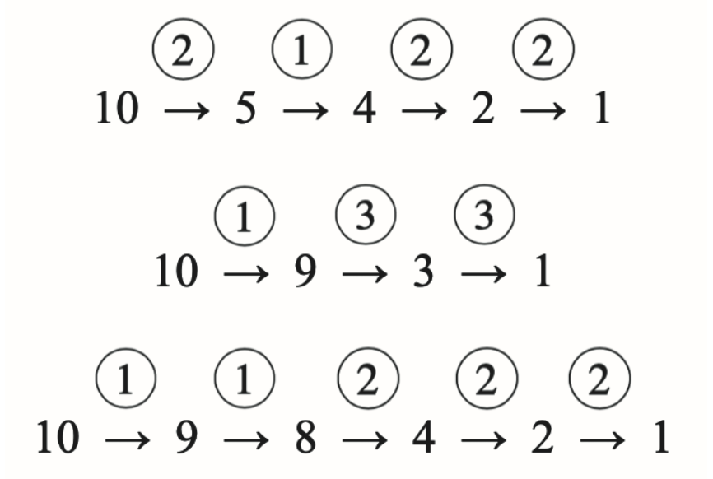
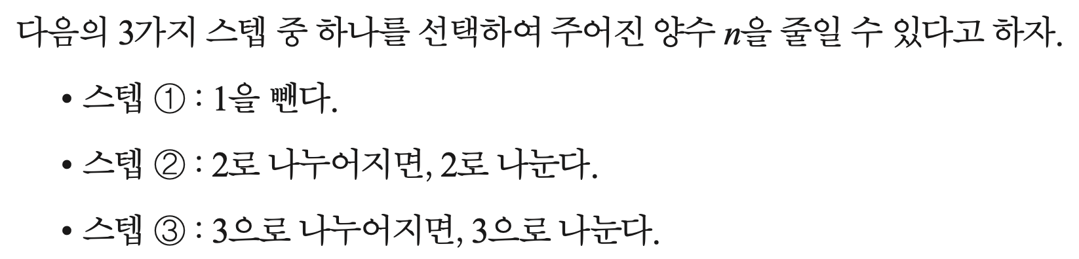

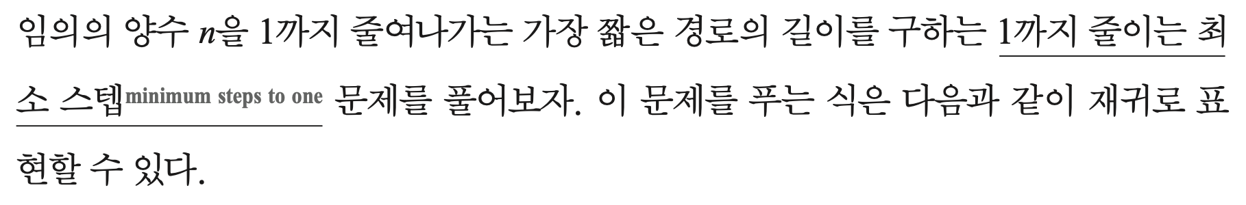
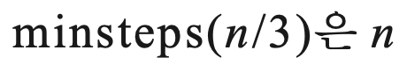
1까지 줄이는 최소 스텝

Slide 92
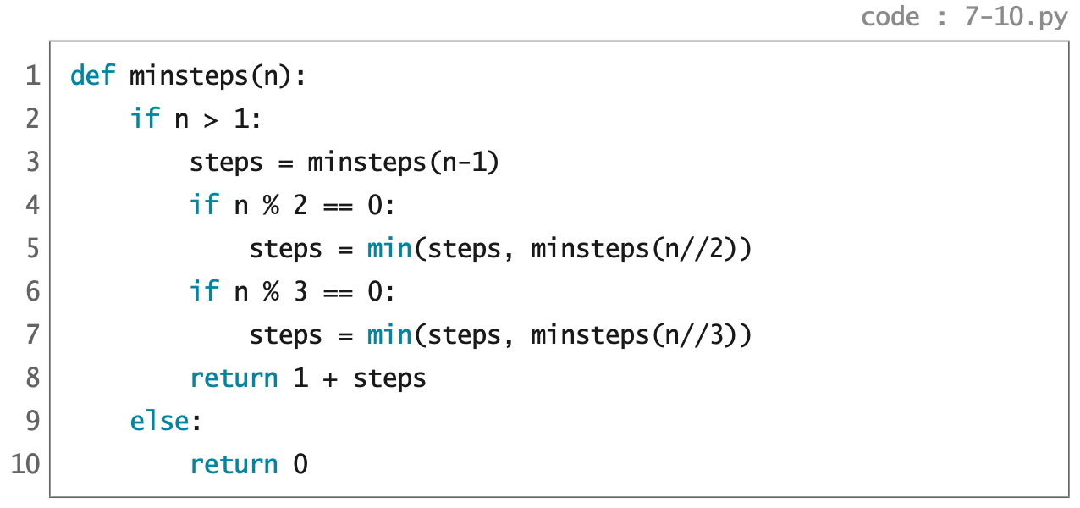
재귀 알고리즘

Slide 93
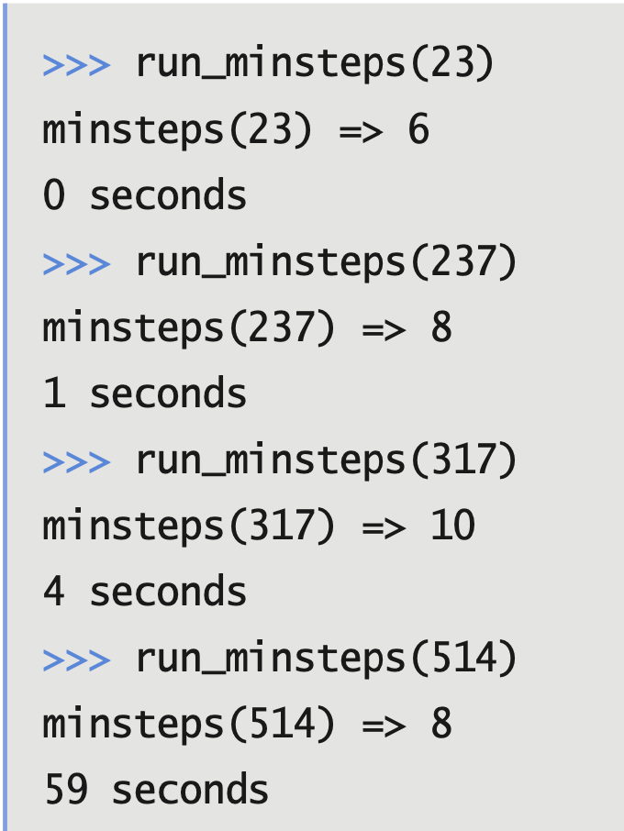
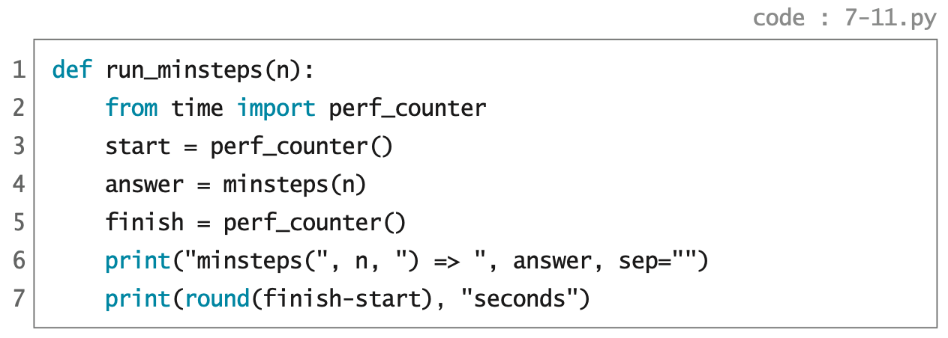
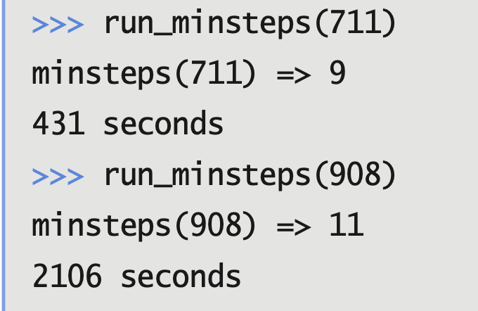

Slide 94
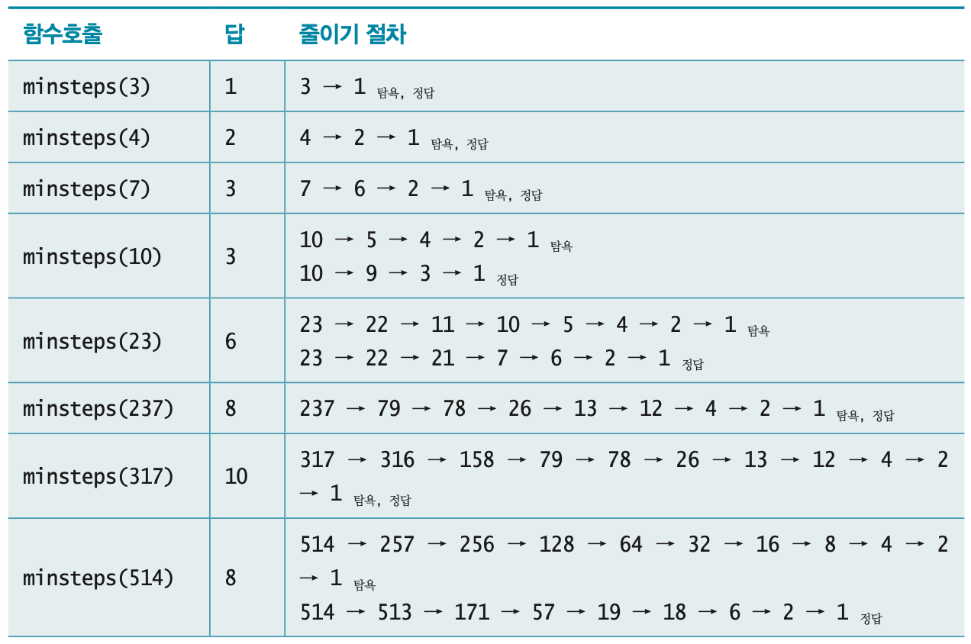
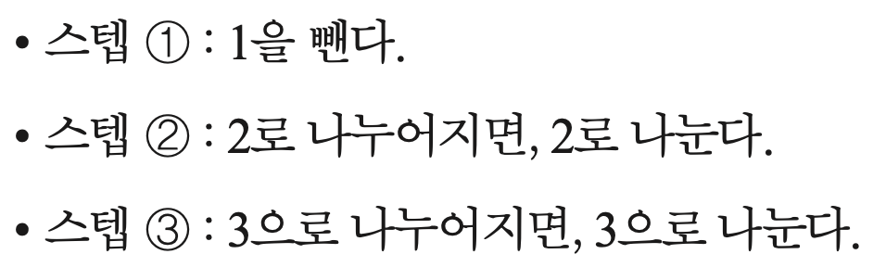
탐욕 알고리즘

Slide 95
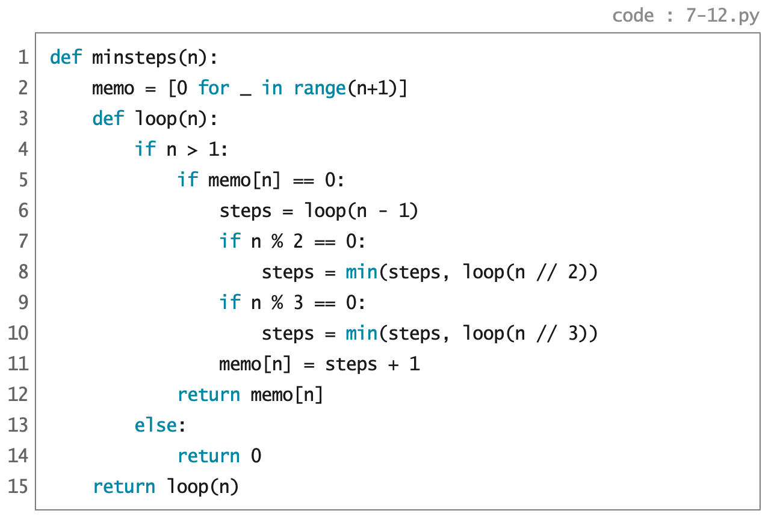
메모해두기 알고리즘

Slide 96
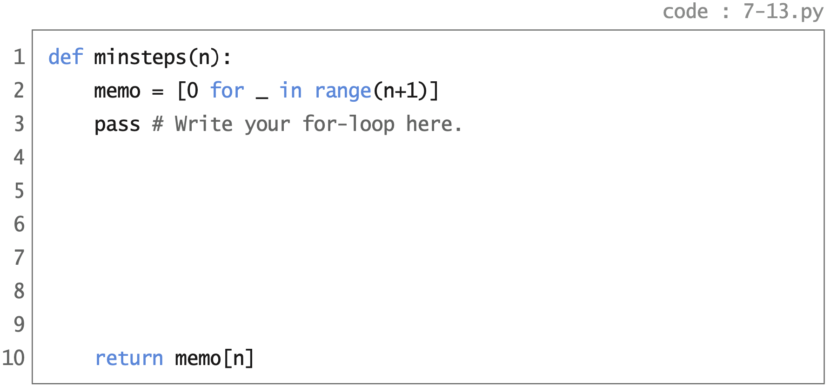
표채워풀기 알고리즘

Slide 97
p.357

Slide 98
✔︎

Slide 99
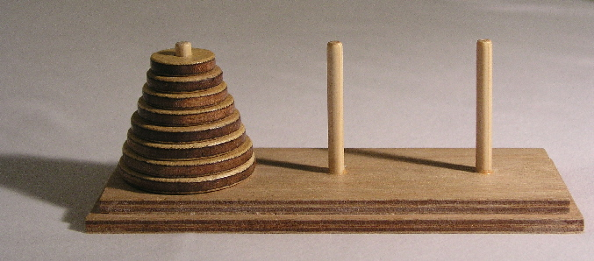
하노이의 탑

Slide 100

하노이의 탑

Slide 101

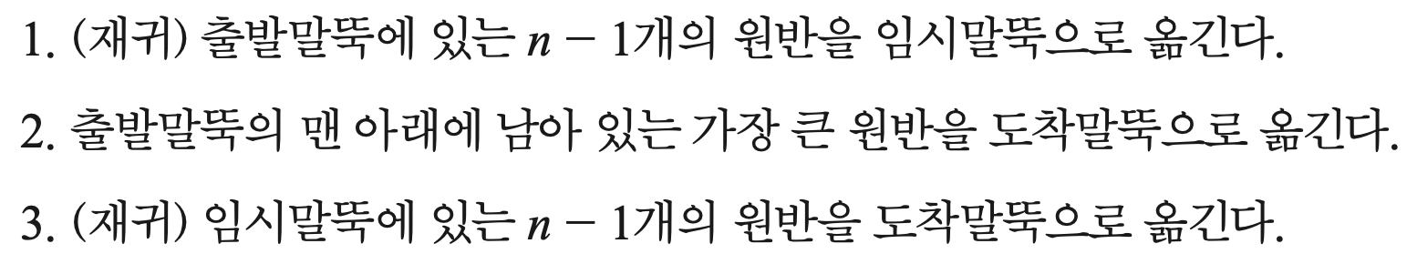
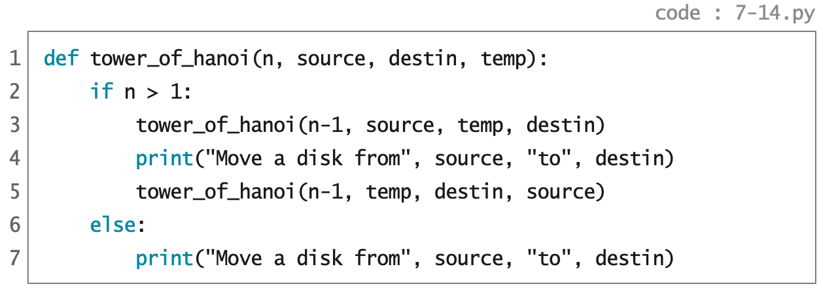
하노이의 탑

Slide 102
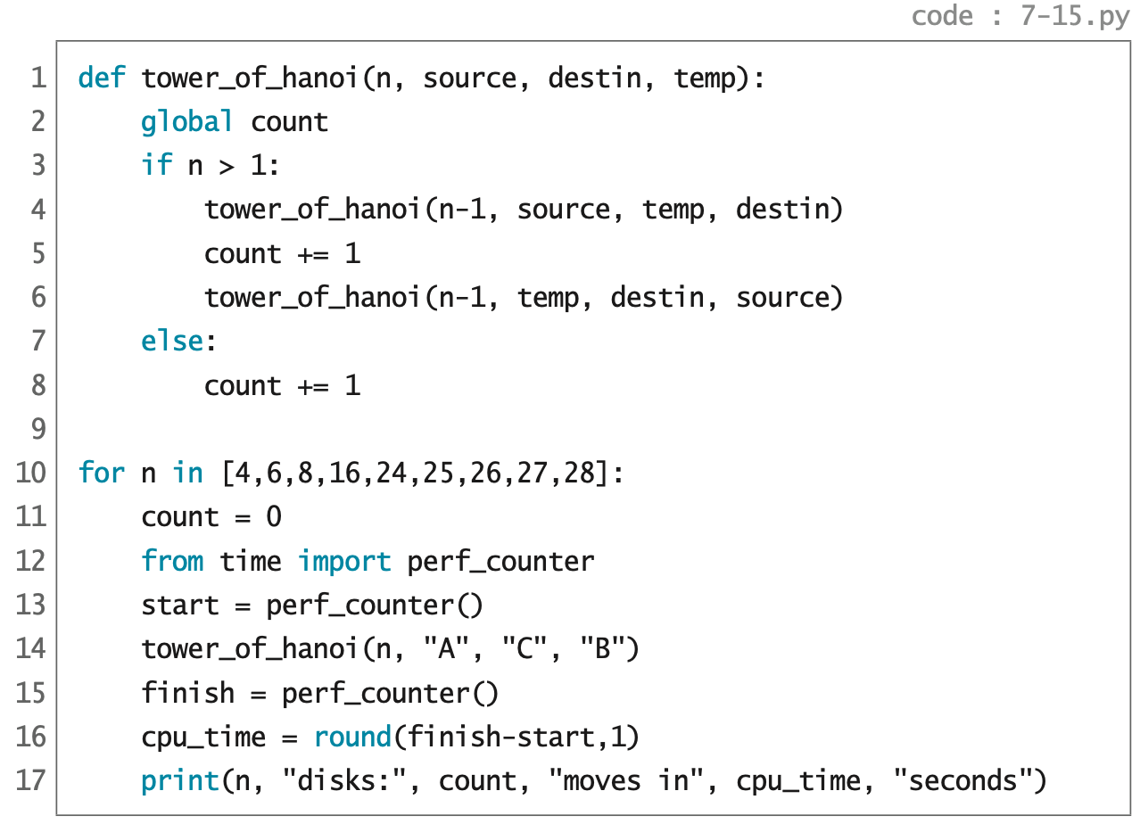
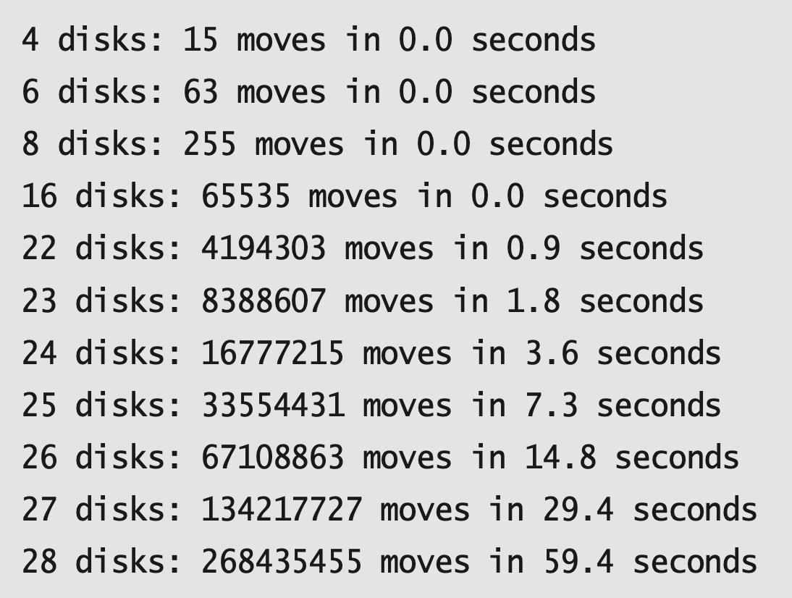
하노이의 탑
실행시간 측정

Slide 103


✔︎
검색 범위
x
==
s[0]
s[1:]
return True
검색 범위
✔︎
x
!=
s[0]
s[1:]

Slide 104

p.362

